Slide 1
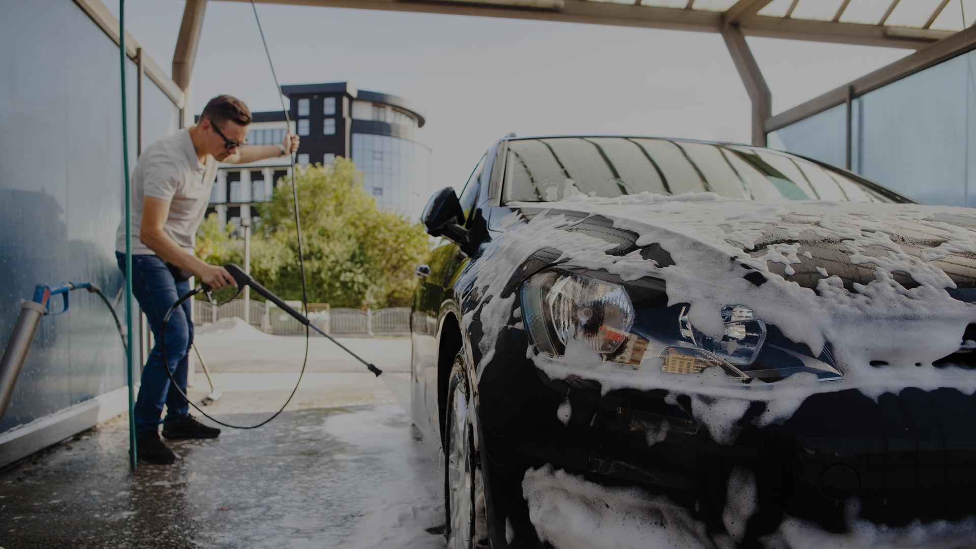
CAR Parking System
By Elites & Ambassador

Slide 2

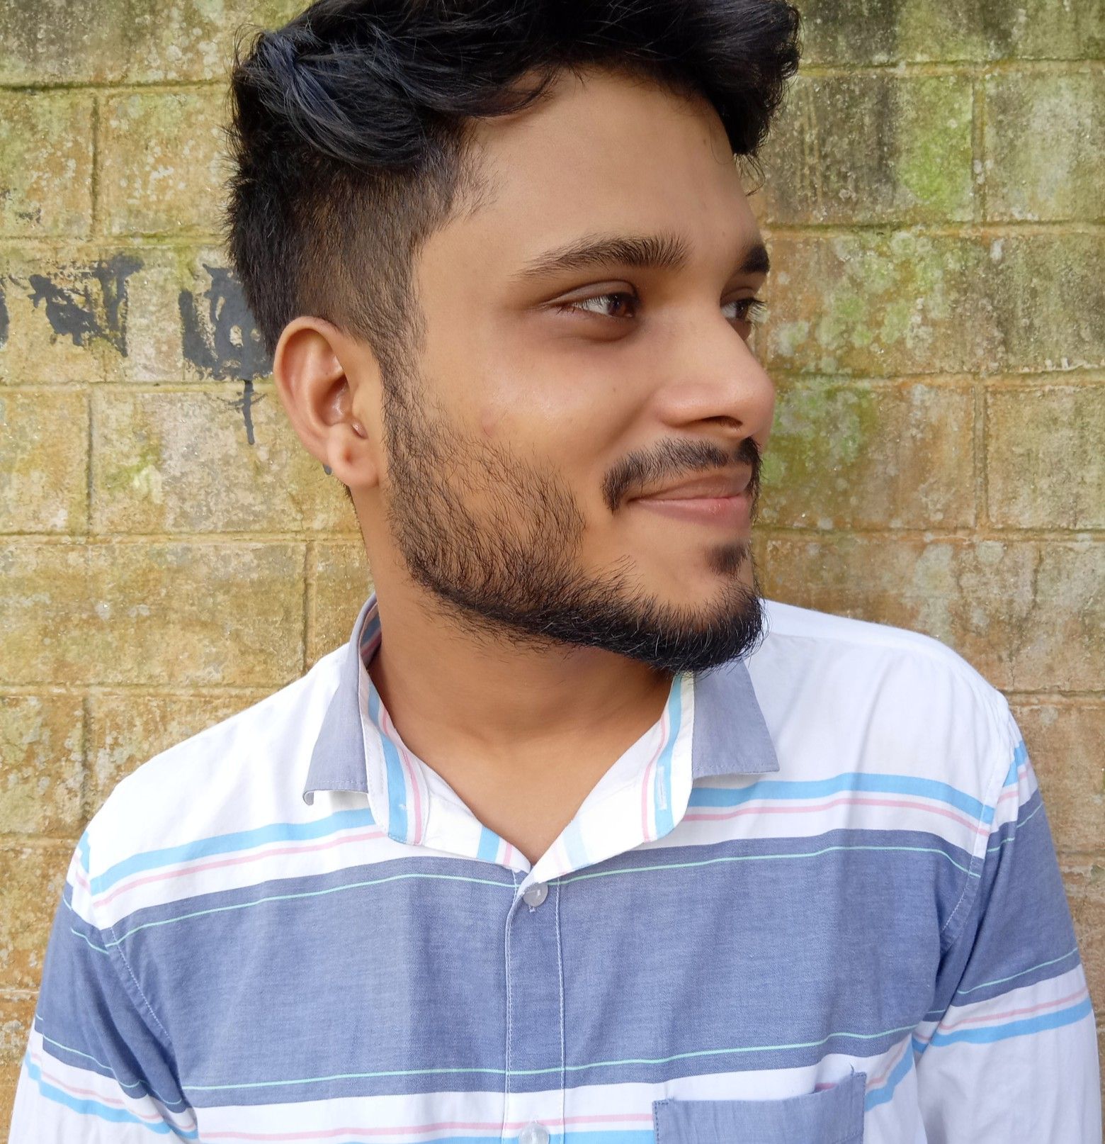

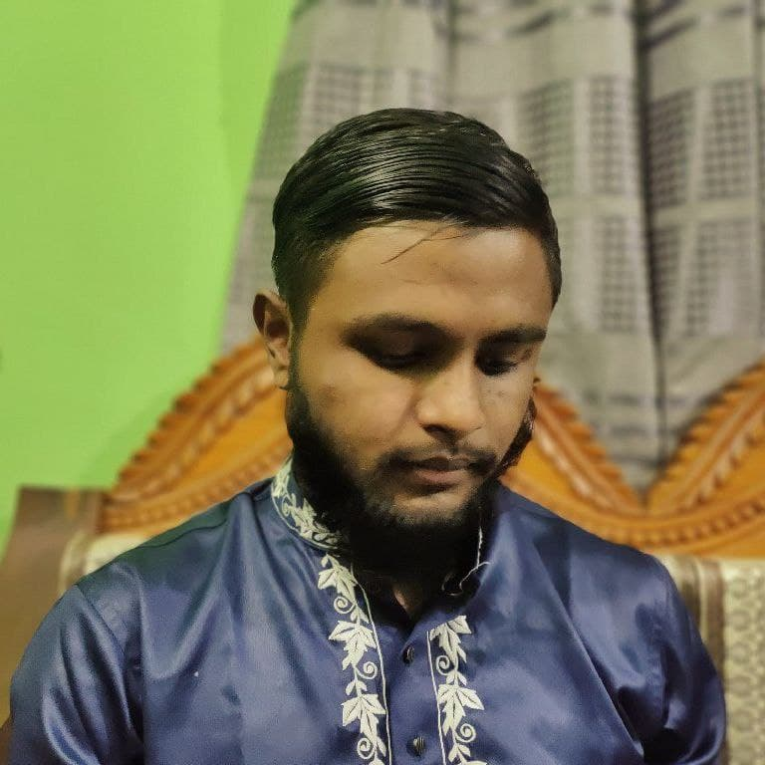
Elites & Ambassador
AZMARY
JAHID
FAHIM
NAZMUL
193902019
193902001
193902022
193902031

Slide 3
TABLE OF CONTENTS
01
02
03
P R O J CT O V ER V I E W
F E A T U R E S
F U T U R E SCOPE
Here you could describe the topic of the section
Here you could describe the topic of the section
Here you could describe the topic of the section

Slide 4

01
PROJCT OVERVIEW

Slide 5
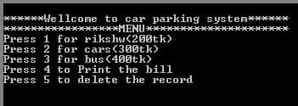
OUR SERVICES
CAR PARKING SYSTEM

Slide 6
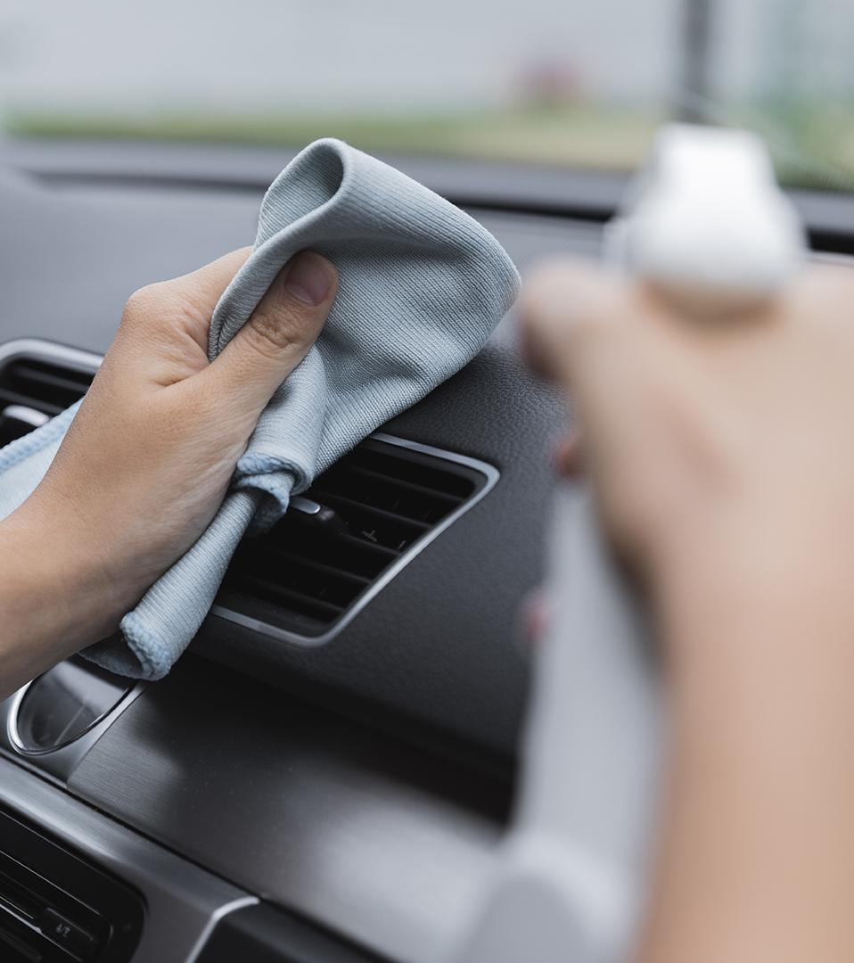
02
F E A T U R E S
MEJOR ENTITY OF OUR PROJECT

Slide 7
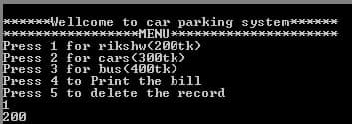
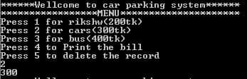
P R O J E C T F E A T U R E S
PARKING MENU & COST

Slide 8
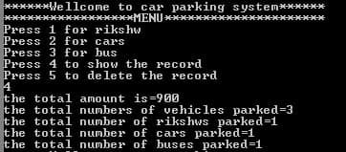
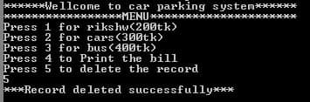
P R O J E C T F E A T U R E S
PRINT THE BILL
DELETE THE RECORDS

Slide 9
03
F U T U R E SCOPE

Slide 10

THANKS!
Do you have any questions?

